Slide 1
Sorting II Searching

Slide 2
Recap – Previous Lecture
O(n²) Sorts
Bubble Sort
Selection Sort
Insertion Sort
swapping elements

Slide 3
Swap Code
static void swap(ref int x, ref int y)
{
int temp = x;
x = y;
y = temp;
}
int a = 93; int b = 44;
swap(ref a, ref b);
a = 44, b =93
2nd
x
1st
y
3nd
temp

Slide 4
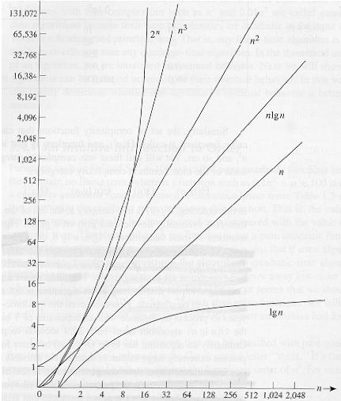
Common orders of magnitude
bubble sort
selection sort
Insertion sort
bad
not so good
execution
time
good
very fast
size input

Slide 5
Common orders of magnitude
bubble sort
selection sort
Insertion sort
bad
not so good
quicksort
execution
time
good
very fast
size input

Slide 6
Divide and Conquer
“Divide and Conquer” Algorithms
Divide: Break the problem into subproblems (simpler) of same type
Conquer: Solve those subproblems
Appropriately combine the answers of the subproblems to get the answer of the full problem

Slide 7
Divide and Conquer
left subtree
right subtree
Height(tree)
if tree is empty then Height(tree) is 0
else
Height(tree) is :
largest(Height(left subtree), Height(right subtree)) +1

Slide 8
Divide and Conquer Sortings
QuickSort

Slide 9
QuickSort Introduction
Normally considered the best general purpose sort algorithm

Slide 10
QuickSort Basics
QuickSort on Full Array
81 | 31 | 75 | 57 | 92 | 13 | 43 | 65 | 26 | 0
Select Pivot
81 | 31 | 75 | 57 | 92 | 13 | 43 | 65 | 26 | 0

Slide 11
QuickSort Basics
QuickSort on Full Array
81 | 31 | 75 | 57 | 92 | 13 | 43 | 65 | 26 | 0
Select Pivot
81 | 31 | 75 | 57 | 92 | 13 | 43 | 65 | 26 | 0
Partition
< pivot
> = pivot
31 | 57 | 13 | 43 | 26 | 0
65
81 | 75 | 92
Create two partitions:
with all elements < pivot
with all elements >= pivot

Slide 12
QuickSort Basics
QuickSort on Full Array
81 | 31 | 75 | 57 | 92 | 13 | 43 | 65 | 26 | 0
Select Pivot
81 | 31 | 75 | 57 | 92 | 13 | 43 | 65 | 26 | 0
Partition
< pivot
> = pivot
31 | 57 | 13 | 43 | 26 | 0
65
81 | 75 | 92
Create two partitions:
with all elements < pivot
with all elements >= pivot
pivot choice is arbitrary (any number can be chosen as pivot)

Slide 13
QuickSort Basics
QuickSort on Full Array
81 | 31 | 75 | 57 | 92 | 13 | 43 | 65 | 26 | 0
Select Pivot
81 | 31 | 75 | 57 | 92 | 13 | 43 | 65 | 26 | 0
Partition
< pivot
> = pivot
31 | 57 | 13 | 43 | 26 | 0
65
81 | 75 | 92
Quicksort on Partitions
0 | 13 | 26 | 31 | 43 | 57

Slide 14
QuickSort Basics
QuickSort on Full Array
81 | 31 | 75 | 57 | 92 | 13 | 43 | 65 | 26 | 0
Select Pivot
81 | 31 | 75 | 57 | 92 | 13 | 43 | 65 | 26 | 0
Partition
< pivot
> = pivot
31 | 57 | 13 | 43 | 26 | 0
65
81 | 75 | 92
Quicksort on Partitions
0 | 13 | 26 | 31 | 43 | 57
65
75 | 81 | 92

Slide 15
QuickSort Basics
QuickSort on Full Array
81 | 31 | 75 | 57 | 92 | 13 | 43 | 65 | 26 | 0
Select Pivot
81 | 31 | 75 | 57 | 92 | 13 | 43 | 65 | 26 | 0
Partition
< pivot
> = pivot
31 | 57 | 13 | 43 | 26 | 0
65
81 | 75 | 92
Quicksort on Partitions
0 | 13 | 26 | 31 | 43 | 57
65
75 | 81 | 92
Idea Quicksort: Solve the big problem (sorting a full array)
by solving 2 simpler problems (sorting two smaller arrays)

Slide 16
QuickSort Basics
QuickSort on Full Array
81 | 31 | 75 | 57 | 92 | 13 | 43 | 65 | 26 | 0
Select Pivot
81 | 31 | 75 | 57 | 92 | 13 | 43 | 65 | 26 | 0
Partition
< pivot
> = pivot
31 | 57 | 13 | 43 | 26 | 0
65
81 | 75 | 92
Quicksort on Partitions
0 | 13 | 26 | 31 | 43 | 57
65
75 | 81 | 92
Idea Quicksort: Solve the big problem (sorting a full array)
by solving 2 simpler problems (sorting two smaller arrays)
Repeat until there are partitions with just 1 element (no sort) needed

Slide 17
Partitioning: Idea
pivot
10
9 | 5 | 20 | 50 | 10 | 30 | 4 | 12 | 15
i |  |  |  |  |  |  |  | j
9 | 5 | 20 | 50 | 10 | 30 | 4 | 12 | 15
 |  | i |  |  |  | j
9 | 5 | 4 | 50 | 10 | 30 | 20 | 12 | 15
 |  | i |  |  |  | j
9 | 5 | 4 | 50 | 10 | 30 | 20 | 12 | 15
 |  |  | i | j
9 | 5 | 4 | 10 | 50 | 30 | 20 | 12 | 15
 |  |  | j | i

Slide 18
Partitioning
int i, j;
i = left; j = right;
int pivot = items[left];
while (i <= j)
{
for (; (items[i] < pivot) && (i < right); i++) ;
for (; (pivot < items[j]) && (j > left); j--) ;
if (i <= j)
swap(ref items[i++], ref items[j--]);
}

Slide 19
Partitioning
left
right
int i, j;
i = left; j = right;
int pivot = items[left];
while (i <= j)
{
for (; (items[i] < pivot) && (i < right); i++) ;
for (; (pivot < items[j]) && (j > left); j--) ;
if (i <= j)
swap(ref items[i++], ref items[j--]);
}
15, 1, 4, 16, 3, 7, 20, 21, 1, 22
i
j
pivot =15

Slide 20
Partitioning
left
right
int i, j;
i = left; j = right;
int pivot = items[left];
while (i <= j)
{
for (; (items[i] < pivot) && (i < right); i++) ;
for (; (pivot < items[j]) && (j > left); j--) ;
if (i <= j)
swap(ref items[i++], ref items[j--]);
}
15, 1, 4, 16, 3, 7, 20, 21, 1, 22
i
j
pivot =15
15, 1, 4, 16, 3, 7, 20, 21, 1, 22
i

Slide 21
Partitioning
left
right
int i, j;
i = left; j = right;
int pivot = items[left];
while (i <= j)
{
for (; (items[i] < pivot) && (i < right); i++) ;
for (; (pivot < items[j]) && (j > left); j--) ;
if (i <= j)
swap(ref items[i++], ref items[j--]);
}
15, 1, 4, 16, 3, 7, 20, 21, 1, 22
i
j
pivot =15
15, 1, 4, 16, 3, 7, 20, 21, 1, 22
i
j

Slide 22
Partitioning
left
right
int i, j;
i = left; j = right;
int pivot = items[left];
while (i <= j)
{
for (; (items[i] < pivot) && (i < right); i++) ;
for (; (pivot < items[j]) && (j > left); j--) ;
if (i <= j)
swap(ref items[i++], ref items[j--]);
}
15, 1, 4, 16, 3, 7, 20, 21, 1, 22
i
j
pivot =15
15, 1, 4, 16, 3, 7, 20, 21, 1, 22
i
j
1, 1, 4, 16, 3, 7,20, 21, 15, 22
i
j

Slide 23
Partitioning
left
right
int i, j;
i = left; j = right;
int pivot = items[left];
while (i <= j)
{
for (; (items[i] < pivot) && (i < right); i++) ;
for (; (pivot < items[j]) && (j > left); j--) ;
if (i <= j)
swap(ref items[i++], ref items[j--]);
}
15, 1, 4, 16, 3, 7, 20, 21, 1, 22
i
j
pivot =15
15, 1, 4, 16, 3, 7, 20, 21, 1, 22
i
j
1, 1, 4, 16, 3, 7,20, 21, 15, 22
i
j

Slide 24
Partitioning
left
right
int i, j;
i = left; j = right;
int pivot = items[left];
while (i <= j)
{
for (; (items[i] < pivot) && (i < right); i++) ;
for (; (pivot < items[j]) && (j > left); j--) ;
if (i <= j)
swap(ref items[i++], ref items[j--]);
}
15, 1, 4, 16, 3, 7, 20, 21, 1, 22
i
j
pivot =15
15, 1, 4, 16, 3, 7, 20, 21, 1, 22
i
j
1, 1, 4, 16, 3, 7,20, 21, 15, 22
i
j
1, 1, 4, 16, 3, 7,20, 21, 15, 22
i

Slide 25
Partitioning
left
right
int i, j;
i = left; j = right;
int pivot = items[left];
while (i <= j)
{
for (; (items[i] < pivot) && (i < right); i++) ;
for (; (pivot < items[j]) && (j > left); j--) ;
if (i <= j)
swap(ref items[i++], ref items[j--]);
}
15, 1, 4, 16, 3, 7, 20, 21, 1, 22
i
j
pivot =15
15, 1, 4, 16, 3, 7, 20, 21, 1, 22
i
j
1, 1, 4, 16, 3, 7,20, 21, 15, 22
i
j
1, 1, 4, 16, 3, 7,20, 21, 15, 22
i
j

Slide 26
Partitioning
left
right
int i, j;
i = left; j = right;
int pivot = items[left];
while (i <= j)
{
for (; (items[i] < pivot) && (i < right); i++) ;
for (; (pivot < items[j]) && (j > left); j--) ;
if (i <= j)
swap(ref items[i++], ref items[j--]);
}
15, 1, 4, 16, 3, 7, 20, 21, 1, 22
i
j
pivot =15
15, 1, 4, 16, 3, 7, 20, 21, 1, 22
i
j
1, 1, 4, 16, 3, 7,20, 21, 15, 22
i
j
1, 1, 4, 16, 3, 7,20, 21, 15, 22
i
j
1, 1, 4, 7, 3, 16,20, 21, 15, 22
i
j

Slide 27
Partitioning
left
right
int i, j;
i = left; j = right;
int pivot = items[left];
while (i <= j)
{
for (; (items[i] < pivot) && (i < right); i++) ;
for (; (pivot < items[j]) && (j > left); j--) ;
if (i <= j)
swap(ref items[i++], ref items[j--]);
}
15, 1, 4, 16, 3, 7, 20, 21, 1, 22
i
j
pivot =15
15, 1, 4, 16, 3, 7, 20, 21, 1, 22
i
j
1, 1, 4, 16, 3, 7,20, 21, 15, 22
i
j
1, 1, 4, 16, 3, 7,20, 21, 15, 22
i
j
1, 1, 4, 7, 3, 16,20, 21, 15, 22
i
j
1, 1, 4, 7, 3, 16,20, 21, 15, 22
j
i

Slide 28
Partitioning
left
right
int i, j;
i = left; j = right;
int pivot = items[left];
while (i <= j)
{
for (; (items[i] < pivot) && (i < right); i++) ;
for (; (pivot < items[j]) && (j > left); j--) ;
if (i <= j)
swap(ref items[i++], ref items[j--]);
}
15, 1, 4, 16, 3, 7, 20, 21, 1, 22
i
j
pivot =15
15, 1, 4, 16, 3, 7, 20, 21, 1, 22
i
j
1, 1, 4, 16, 3, 7,20, 21, 15, 22
i
j
1, 1, 4, 16, 3, 7,20, 21, 15, 22
i
j
1, 1, 4, 7, 3, 16,20, 21, 15, 22
i
j
1, 1, 4, 7, 3, 16,20, 21, 15, 22
j
i

Slide 29

Partitioning
left
right
int i, j;
i = left; j = right;
int pivot = items[left];
while (i <= j)
{
for (; (items[i] < pivot) && (i < right); i++) ;
for (; (pivot < items[j]) && (j > left); j--) ;
if (i <= j)
swap(ref items[i++], ref items[j--]);
}
15, 1, 4, 16, 3, 7, 20, 21, 1, 22
i
j
pivot =15
15, 1, 4, 16, 3, 7, 20, 21, 1, 22
i
j
1, 1, 4, 16, 3, 7,20, 21, 15, 22
i
j
1, 1, 4, 16, 3, 7,20, 21, 15, 22
i
j
1, 1, 4, 7, 3, 16,20, 21, 15, 22
i
j
partition completed
1, 1, 4, 7, 3, 16,20, 21, 15, 22
i

Slide 30
QuickSort
void quickSortDD2(int[] items, int left, int right)
{
int i, j;
i = left; j = right;
int pivot = items[left];
while (i <= j)
{
for (; (items[i] < pivot) && (i < right); i++) ;
for (; (pivot < items[j]) && (j > left); j--) ;
if (i <= j)
swap(ref items[i++], ref items[j--]);
}
if (left < j) quickSortDD2(items, left, j);
if (i < right) quickSortDD2(items, i, right);
}
left
right
1, 1, 4, 7, 3, 16,20, 21, 15, 22
i
partitioning

Slide 31
QuickSort
void quickSortDD2(int[] items, int left, int right)
{
int i, j;
i = left; j = right;
int pivot = items[left];
while (i <= j)
{
for (; (items[i] < pivot) && (i < right); i++) ;
for (; (pivot < items[j]) && (j > left); j--) ;
if (i <= j)
swap(ref items[i++], ref items[j--]);
}
if (left < j) quickSortDD2(items, left, j);
if (i < right) quickSortDD2(items, i, right);
}
left
right
1, 1, 4, 7, 3, 16,20, 21, 15, 22
i
partitioning
recursive call:
sort the two partitions
(if they have at least 2 elements; partitions with
1 element are already sorted)

Slide 32
Analysis of Quick Sort
Best case: split in the middle — O(n log n)
Worst case: sorted array! — O(n²) rare
Average case: random arrays — O(n log n)

Slide 33
Analysis of Quick Sort
Best case: split in the middle — O(n log n)
Worst case: sorted array! — O(n²) rare
Average case: random arrays — O(n log n)
Improvements – different choices of pivot (try to split into equal partitions)
Leftmost element
left
right
15, 1, 4, 16, 3, 7, 20, 21, 1, 22, 65
i
pivot =15
j

Slide 34
Analysis of Quick Sort
Best case: split in the middle — O(n log n)
Worst case: sorted array! — O(n²) rare
Average case: random arrays — O(n log n)
Improvements – different choices of pivot (try to split into equal partitions)
Rightmost element
left
right
15, 1, 4, 16, 3, 7, 20, 21, 1, 22, 65
i
pivot =65
j

Slide 35
Analysis of Quick Sort
Best case: split in the middle — O(n log n)
Worst case: sorted array! — O(n²) rare
Average case: random arrays — O(n log n)
Improvements – different choices of pivot (try to split into equal partitions)
Random element
left
right
15, 1, 4, 16, 3, 7, 20, 21, 1, 22, 65
i
j

Slide 36
Analysis of Quick Sort
Best case: split in the middle — O(n log n)
Worst case: sorted array! — O(n²) rare
Average case: random arrays — O(n log n)
Improvements – different choices of pivot (try to split into equal partitions)
Median of 3 elements (left, right, middle): 15, 7, 65
left
right
15, 1, 4, 16, 3, 7, 20, 21, 1, 22, 65
i
pivot =15
j

Slide 37
Analysis of Quick Sort
Best case: split in the middle — O(n log n)
Worst case: sorted array! — O(n²) rare
Average case: random arrays — O(n log n)
Improvements – different choices of pivot (try to split into equal partitions)
Median of 3 elements (left, right, middle): 15, 7, 65
left
right
15, 1, 4, 16, 3, 7, 20, 21, 1, 22, 65
i
pivot =15
j
QuickSort, standard sorting algorithm for large files
(n >10000)

Slide 38
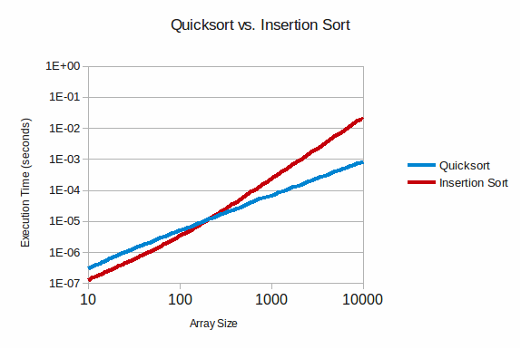
Quicksort vs Insertion Sort
Quicksort: overhead recursion, bad for small arrays

Slide 39
Quicksort vs Insertion Sort
Could we improve QuickSort ?

Slide 40
Searching

Slide 41
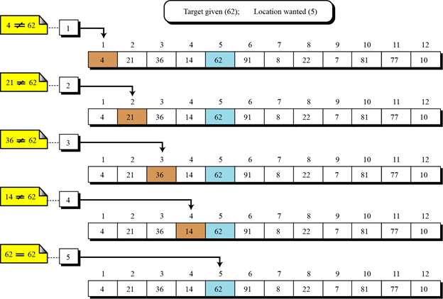
Sequential Search
Function Search(array, value )
Foreach element in array
Found := false;
Begin
If element = value
Found := true
Exit loop
End if
End
Return found
End Function

Slide 42
Sequential Search
O(n)
Function Search(array, value )
Foreach element in array
Found := false;
Begin
If element = value
Found := true
Exit loop
End if
End
Return found
End Function

Slide 43
Search in a sorted array can be much more efficient

Slide 44
Binary Search
78
10 | 15 | 22 | 24 | 32 | 43 | 45 | 57 | 59 | 65 | 70 | 78 | 81 | 82 | 85 | 88 | 90 | 94 | 96 | 98
L |  |  |  |  |  |  |  |  |  |  |  |  |  |  |  |  |  |  | H

Slide 45
Binary Search
78
10 | 15 | 22 | 24 | 32 | 43 | 45 | 57 | 59 | 65 | 70 | 78 | 81 | 82 | 85 | 88 | 90 | 94 | 96 | 98
L |  |  |  |  |  |  |  |  | mid |  |  |  |  |  |  |  |  |  | H

Slide 46
Binary Search
78
10 | 15 | 22 | 24 | 32 | 43 | 45 | 57 | 59 | 65 | 70 | 78 | 81 | 82 | 85 | 88 | 90 | 94 | 96 | 98
L |  |  |  |  |  |  |  |  | mid |  |  |  |  |  |  |  |  |  | H
array is sorted
78 can only be here

Slide 47
Binary Search
78
10 | 15 | 22 | 24 | 32 | 43 | 45 | 57 | 59 | 65 | 70 | 78 | 81 | 82 | 85 | 88 | 90 | 94 | 96 | 98
L |  |  |  |  |  |  |  |  |  |  |  |  |  | mid |  |  |  |  | H

Slide 48
Binary Search
78
10 | 15 | 22 | 24 | 32 | 43 | 45 | 57 | 59 | 65 | 70 | 78 | 81 | 82 | 85 | 88 | 90 | 94 | 96 | 98
L |  |  |  |  |  |  |  |  |  |  |  |  |  | mid |  |  |  |  | H
78 can only be here

Slide 49
Binary Search
78
10 | 15 | 22 | 24 | 32 | 43 | 45 | 57 | 59 | 65 | 70 | 78 | 81 | 82 | 85 | 88 | 90 | 94 | 96 | 98
L |  |  |  |  |  |  |  |  |  |  | mid |  |  |  |  |  |  |  | H
array[mid] == 78
found !

Slide 50
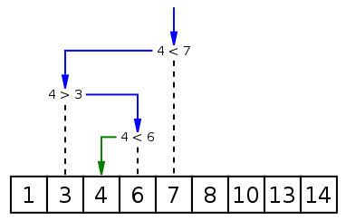
Binary Search
4

Slide 51
Binary Search Recursive
Function BinarySearch(A, value, low, high)
if high < low
return false
mid = round((low + high) / 2)
if A[mid] > value
then return BinarySearch(A, value, low, mid-1)
else if A[mid] < value
return BinarySearch(A, value, mid+1, high)
else
return true // item found
End Function
1
5
20
30
37
50
76
0 1 2 3 4 5 6

Slide 52
Binary Search Recursive
Function BinarySearch(A, value, low, high)
if high < low
return false
mid = round((low + high) / 2)
if A[mid] > value
then return BinarySearch(A, value, low, mid-1)
else if A[mid] < value
return BinarySearch(A, value, mid+1, high)
else
return true // item found
End Function
A
1
5
20
30
37
50
76
0 1 2 3 4 5 6
BinarySearch (A, 37, 0, 6)

Slide 53
Binary Search Recursive
Function BinarySearch(A, value, low, high)
if high < low
return false
mid = round((low + high) / 2)
if A[mid] > value
then return BinarySearch(A, value, low, mid-1)
else if A[mid] < value
return BinarySearch(A, value, mid+1, high)
else
return true // item found
End Function
A
1
5
20
30
37
50
76
0 1 2 3 4 5 6
BinarySearch (A, 37, 0, 6)

Slide 54
Binary Search Recursive
Function BinarySearch(A, value, low, high)
if high < low
return false
mid = round((low + high) / 2)
if A[mid] > value
then return BinarySearch(A, value, low, mid-1)
else if A[mid] < value
return BinarySearch(A, value, mid+1, high)
else
return true // item found
End Function
mid
A
1
5
20
30
37
50
76
0 1 2 3 4 5 6
BinarySearch (A, 37, 0, 6)

Slide 55
Binary Search Recursive
Function BinarySearch(A, value, low, high)
if high < low
return false
mid = round((low + high) / 2)
if A[mid] > value
then return BinarySearch(A, value, low, mid-1)
else if A[mid] < value
return BinarySearch(A, value, mid+1, high)
else
return true // item found
End Function
mid
A
1
5
20
30
37
50
76
0 1 2 3 4 5 6
BinarySearch (A, 37, 4, 6)

Slide 56
Binary Search Recursive
Function BinarySearch(A, value, low, high)
if high < low
return false
mid = round((low + high) / 2)
if A[mid] > value
then return BinarySearch(A, value, low, mid-1)
else if A[mid] < value
return BinarySearch(A, value, mid+1, high)
else
return true // item found
End Function
mid
A
1
5
20
30
37
50
76
0 1 2 3 4 5 6
BinarySearch (A, 37, 4, 6)

Slide 57
Binary Search Recursive
Function BinarySearch(A, value, low, high)
if high < low
return false
mid = round((low + high) / 2)
if A[mid] > value
then return BinarySearch(A, value, low, mid-1)
else if A[mid] < value
return BinarySearch(A, value, mid+1, high)
else
return true // item found
End Function
mid
A
1
5
20
30
37
50
76
0 1 2 3 4 5 6
BinarySearch (A, 37, 4, 6)

Slide 58
Binary Search Recursive
Function BinarySearch(A, value, low, high)
if high < low
return false
mid = round((low + high) / 2)
if A[mid] > value
then return BinarySearch(A, value, low, mid-1)
else if A[mid] < value
return BinarySearch(A, value, mid+1, high)
else
return true // item found
End Function
mid
A
1
5
20
30
37
50
76
0 1 2 3 4 5 6
BinarySearch (A, 37, 4, 6)

Slide 59
Binary Search Recursive
Function BinarySearch(A, value, low, high)
if high < low
return false
mid = round((low + high) / 2)
if A[mid] > value
then return BinarySearch(A, value, low, mid-1)
else if A[mid] < value
return BinarySearch(A, value, mid+1, high)
else
return true // item found
End Function
A
1
5
20
30
37
50
76
0 1 2 3 4 5 6
BinarySearch (A, 37, 4, 4)

Slide 60
Binary Search Recursive
Function BinarySearch(A, value, low, high)
if high < low
return false
mid = round((low + high) / 2)
if A[mid] > value
then return BinarySearch(A, value, low, mid-1)
else if A[mid] < value
return BinarySearch(A, value, mid+1, high)
else
return true // item found
End Function
A
1
5
20
30
37
50
76
0 1 2 3 4 5 6
BinarySearch (A, 37, 4, 4)

Slide 61
Binary Search Recursive
Function BinarySearch(A, value, low, high)
if high < low
return false
mid = round((low + high) / 2)
if A[mid] > value
then return BinarySearch(A, value, low, mid-1)
else if A[mid] < value
return BinarySearch(A, value, mid+1, high)
else
return true // item found
End Function
A
1
5
20
30
37
50
76
0 1 2 3 4 5 6
mid
BinarySearch (A, 37, 4, 4)

Slide 62
Binary Search Recursive
Function BinarySearch(A, value, low, high)
if high < low
return false
mid = round((low + high) / 2)
if A[mid] > value
then return BinarySearch(A, value, low, mid-1)
else if A[mid] < value
return BinarySearch(A, value, mid+1, high)
else
return true // item found
End Function
A
1
5
20
30
37
50
76
0 1 2 3 4 5 6
mid
BinarySearch (A, 37, 4, 4)

Slide 63
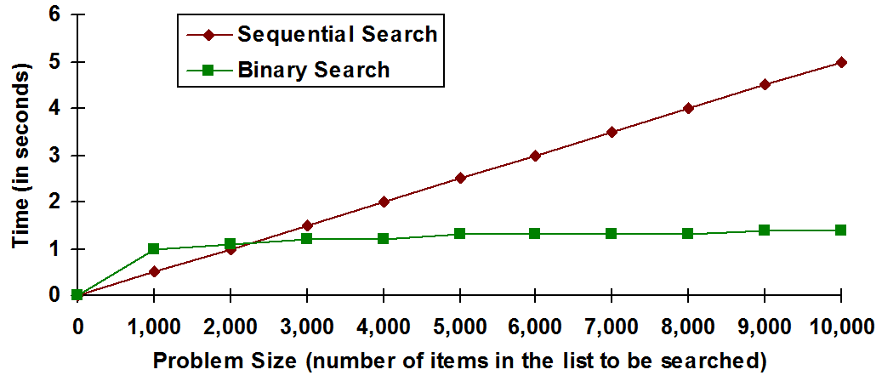
Binary Search vs Sequential Search
Binary Search Worst case: — O(log n)
Sequential Search Worst case: — O(n)

Slide 64
Fast sorting:
Quicksort O(n log n)
Fast Searching (in sorted arrays):
Binary Search O(log n) Search

